Slide 1
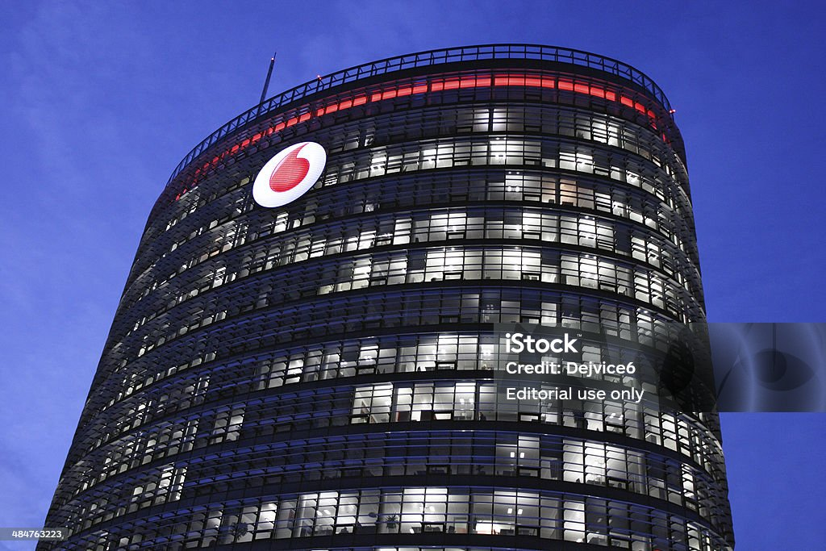
Decoding Customer Retention and Churn: Harnessing Technological Advancements and Predictive Analytics in the Competitive Service Sectors - A Case Study of Vodafone

Slide 2

Introduction
Intense competition in the telecommunications sector due to an increase in customers and companies
Companies employ strategies to retain customers, such as upselling, increasing retention duration, and acquiring new customers
Importance of customer retention for profitability and revenue
Use of machine learning for customer churn prediction based on past data

Slide 3

CHURN PREDICTION
Customer churn prediction is a critical priority across industries like banking, telecom, and insurance. Companies aim to understand what drives customers to leave and develop early warning systems to identify at-risk customers.
With this knowledge, companies can proactively implement retention strategies tailored to resolve specific customer grievances and prevent attrition.

Slide 4

Research Objectives
Gain insights into the core factors causing students dissatisfaction and churn
Detect potential churners before they defect
Identify the main attributes that help the retention department keep customers and prevent churn

Slide 5
Approach Overview
Analyze user-generated content (posts, comments, reviews) using sentiment analysis
Build a dataset through surveys and analyze it using machine learning algorithms such as logistic regression and decision tree.
A predictive methods like survival analysis can be used to check how long a student survives with the vodafone usage.

Slide 6
Limitation
All the colleges that have more than a 4-year course duration were not included in our sample.

Slide 7


Slide 9
Pilot Survey Analysis
A total of 106 sample was taken from a population of about 250 students in KNUST.
Of which it was observed that, the male to female ratio was 60:46.
97 students had the vodaphone sim but only
80 of them claimed to be active users.

Slide 10
Analysis based on College Groupings
Disclaimer: College of Art And Built Environment recorded the most number of active users with college if engineering trailing at the bottom

Slide 11
Analysis on factors that discourage use of Vodaphone
Count of Which network do you use aside the school vodaphone?
 | AirtelTigo | AirtelTigo, MTN | Glo, MTN | Glo, MTN, | MTN | Grand Total
 | 5 | 3 | 1 | 1 | 51 | 61

Slide 12

Thank You

